Slide 1


Cricket Verse
The Ultimate Platform for Your Cricket Passion.

Slide 2
Our Team
Maithil Korat
24002171210085
CSE
Batch- A1
Yuvraj Labana
24002171210081
CSE
Batch- A1
Khushi Mulchandani
24002171410077
CSE
Batch- A1

Slide 3
TABLE OF CONTENTS
01
02
03
04
05
06
Purpose
ER Diagram
Technology Used
Functionalities
Future Scope
Merits and Demerits

Slide 4

01 Purpose

Slide 5
Purpose
The primary purpose of this project is to design and develop a digital cricket scoring application. It aims to replace traditional manual scorekeeping with an automated, efficient, and accurate system. The application allows a user to record a cricket match ball-by-ball, and it automatically calculates and stores detailed career statistics for every player and team involved, creating a persistent and queryable history of all matches played.

Slide 6
02
ER Diagram

Slide 7
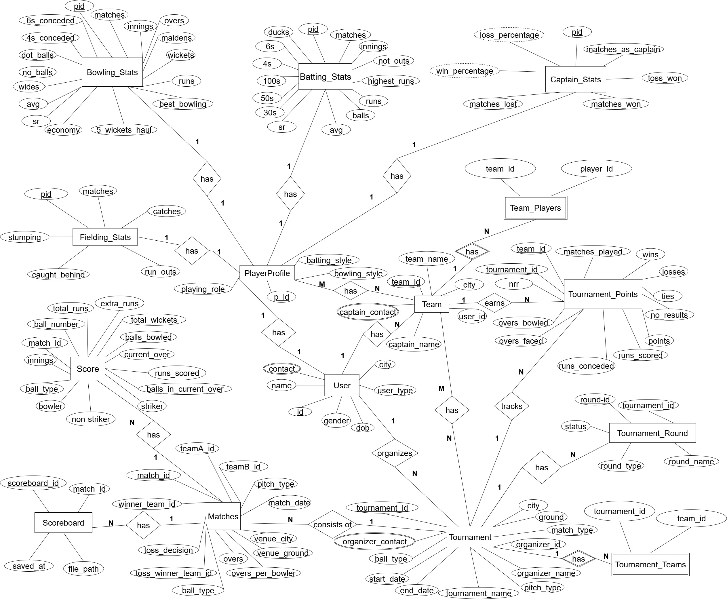

Slide 8

Technology Used
03

Slide 9




Technology Used
Programming Language : Java
Database : MySQL
IDE : IntelliJ IDEA
Framework: JDBC (Java Database Connectivity) for database communication.

Slide 10
04
Funtionalities

Slide 11
Functionalities
Live Scoring : Provides a command-line interface for ball-by-ball scoring of a cricket match.
Automatic Calculations : Automatically computes total runs, wickets, overs, net run rate, and other relevant match data.
Comprehensive Stat : Tracking: Records and persistently stores a wide range of career statistics for each player, including batting average, strike rate, wickets taken, economy rate, and fielding records.
Database Integration : All match and player data is saved to a MySQL database using JDBC, ensuring data integrity and persistence.
Toss and Match Management : Handles the initial match setup, including the toss and determination of batting/bowling order.

Slide 12
Functionalities
DS | JAVA-II | DBMS
Singly Linked List | OOP Concepts – Encapsulation, Inheritance, Polymorphism, Abstraction | Designing relational tables for Users,Stats etc…
 | Exception Handling, I/O Files | SQL Queries – Insert, Update, Delete, Select
 | Packages | Triggers,Procedure
 | JDBC connection

Slide 13


05 Merits &
Demerits

Slide 14
Merits
Accuracy in Scoring – Eliminates manual errors in runs, wickets, extras, and player stats.
Real-Time Updates – Live score tracking for players, teams, and audience.
Data Analytics – Provides insights like strike rate, economy, partnerships, and player performance trends.
User-Friendly Interface – Easier and faster than maintaining paper records.
Historical Record Keeping – Stores past matches and player statistics for future reference.
Scalability – Can be extended to support tournaments, leaderboards, and team management.

Slide 15
Demerits
Limited Features – The system may not support live streaming , Commentary or Audience interactions.
Database Dependency – If the database server goes down, the scoring system cannot function.
Technical Glitches – Bugs, crashes, or database errors can affect match records.
User Interface Simplicity – Console-based UI or basic forms are less attractive compared to modern mobile apps with rich graphics.
Initial Setup Effort – Requires database, backend, and proper hosting to work smoothly.

Slide 16
06
Future Scope

Slide 17
Future Scope
Develop a GUI: Create a user-friendly graphical interface using JavaFX or Swing to make the application accessible to non-technical users.
Web Application: Rebuild the project as a web application (using Spring Boot) to provide a live, online scoreboard that can be viewed by anyone with a browser.
Mobile App: Develop a mobile version for Android/iOS to allow for scoring directly from the field.
Advanced Analytics: Incorporate data visualization tools to generate graphs, charts, and diagrams like wagon wheels and run-rate comparisons.
AI/ML Predictions – Suggest winning probabilities, player performance forecasts, and strategy recommendations.

Slide 18
Thank You

